Slide 1
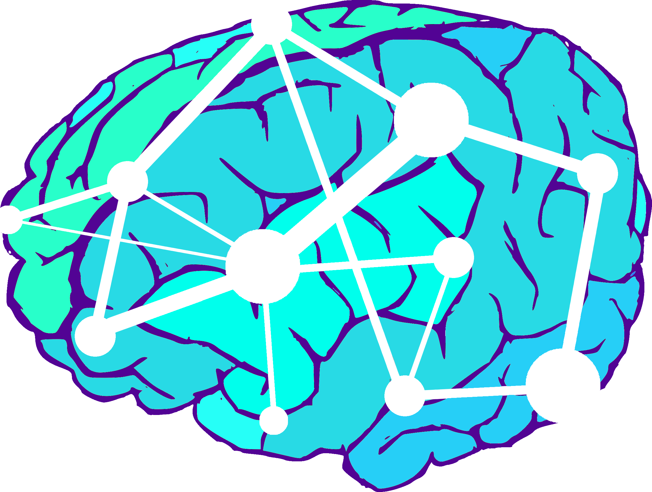
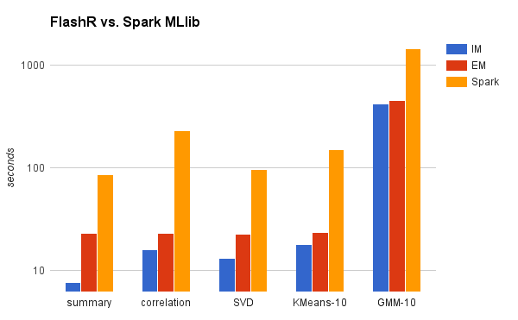
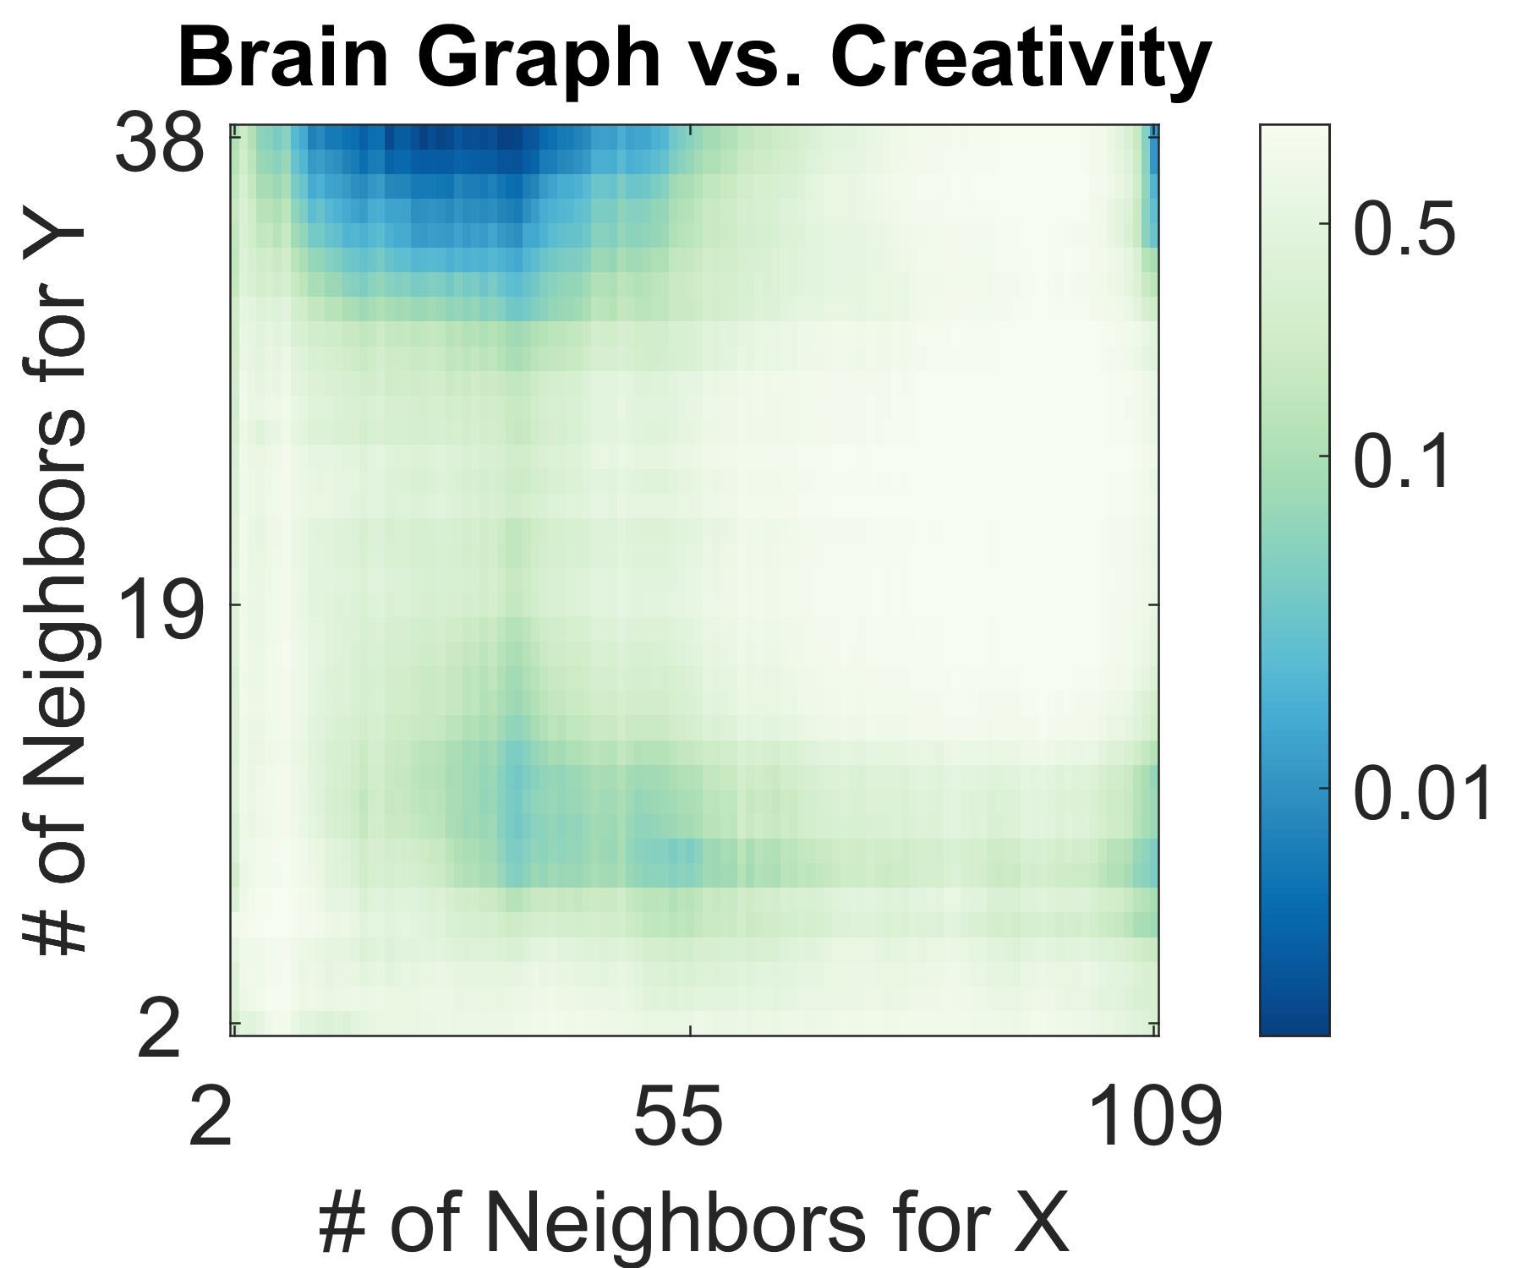
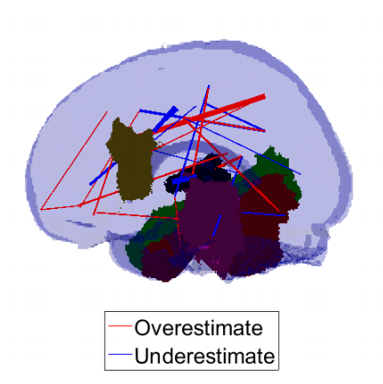
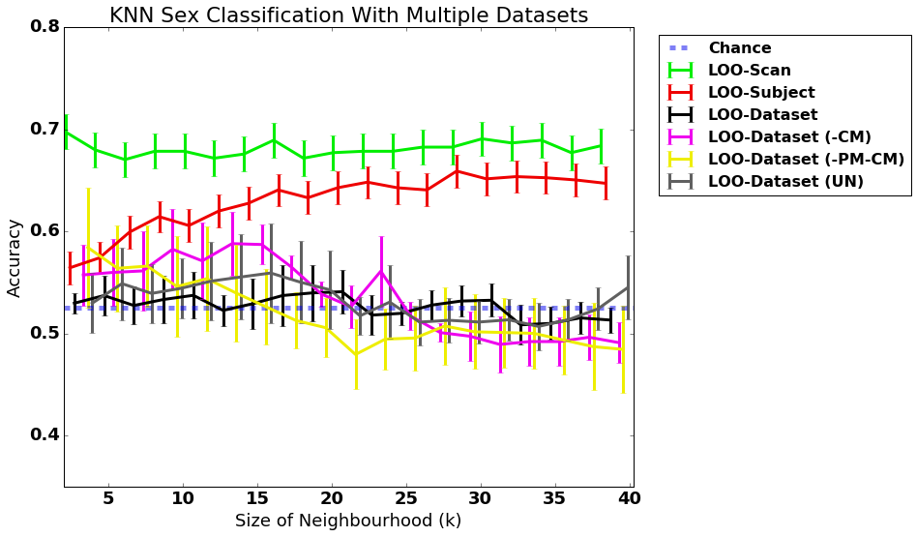
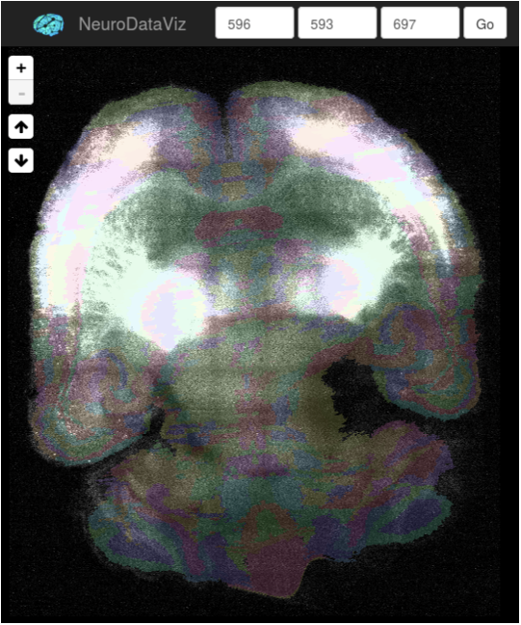
JHU SIMPLEX: Enabling Terascale Neuroscience for Everyone
(1) FlashX for Data Science
Added a variety of generalized matrix operations to FlashX
This enables many basic data science routines to be written in native R code but scale to arbitrarily big data on a single machine
http://flashx.io/
(2) MGC Dependence Testing
Extended previous dependence testing (dcorr) by sparsifying graphs
We now have theory and methods (in MATLAB and R) that statistically dominates the previous best method
Use in several novel neuroscience applications to discover the scales of dependency
https://github.com/jovo/MGC
(3) Law of Large Graphs
Proved spectral regularization is more efficient than naive estimate of of average graph
Proved robust variant is even more efficient in the presence of outliers
Demonstrated on real data to discover false positives and negatives in previous estimates of mean connectome
https://github.com/jhu-graphstat/LLG
(4) MR Batch Effect
Using data data and pipeline from GRAPHS, discovered the existence of batch effects
Simple linear approaches to removing batch effects failed
Extending now to nonlinear models
http://m2g.io
(5) CLARITY
Multimodal LDDMM for registering CLARITY to Atlas and other CLARITY brains
Distributed ROI histogram Web-service
Ingested 12 ~1TB CLARITY brains and registered them each to Allen Atlas
https://github.com/neurodata/ndreg
In summary, we provide a suite of tools and techniques which extend the boundaries of scientific discovery

Slide 2
FlashX for Data Science
Existing big data analytics—for both graph traversal & machine learning—leverage cluster computing, and therefore must deal with a communication bottleneck, because transferring data across computers within a cluster is orders of magnitude slower than other data transfer costs
As one ascends the memory hierarchy, the speed increases by about 10x, eg, across computers > spinning hard disks > solid state disks (SSD) > RAM > Cache
The trick is to keep as much data in fast storage
FlashX uses a semi-external memory model, we store the dense data matrix or sparse graph on a disk array in a single machine, and only keep whatever is necessary for the specific algorithm in RAM
This eliminates the communication bottleneck required for cluster computing.
1 big-memory node can running FlashX outperforms
MLlib for machine learning on same hardware by 10x
300 node cluster running Google’s Pregel for graph traversal
Machine learning algorithms can now utilize FlashX’s parallel data science primitives using native R code, which will substantially accelerate the pace of making more algorithms parallel on single machines.

Slide 3
FlashX is ~10x Faster than MLlib
 | Compuation | I/O
Summary | n*p | n*p
Correlation | n*p^2 | n*p
svd | n*p^2 | n*p
k-means | n*p*k | n*p
gmm | n*p^2*k + p^3*k | n*p + n*k
For each experiment, n=1B, p=32,
summary computes: min, max, mean, L1 norm, L2 norm, nnz

Slide 4
MGC for Dependence Testing
Dependence testing is the first step in many data science problems
Multiscale Generalized Correlation (MGC) is the first approach that works well in high-dimensions, low sample size, arbitrary objects (shapes, graphs, time-series), and provides insight into scales of dependency.
Combined ideas from correlation testing and manifold learning
First theory to prove statistical dominance, meaning that we are always better than (or at least as good as) previous methods.

Slide 5
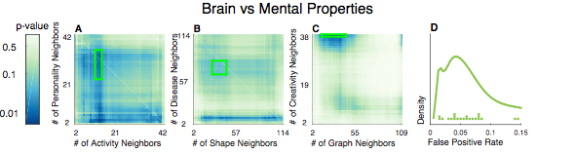
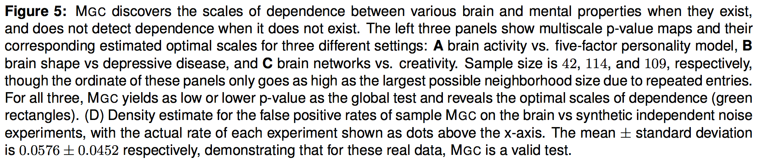

Slide 6
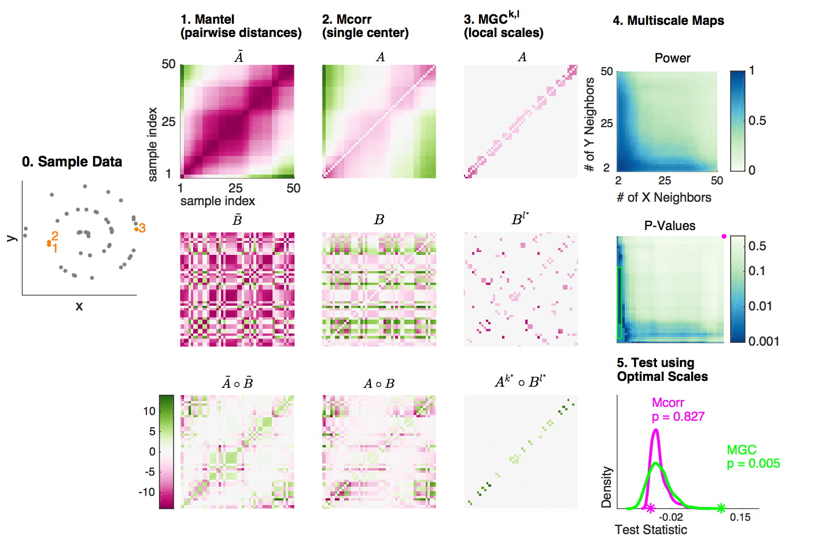
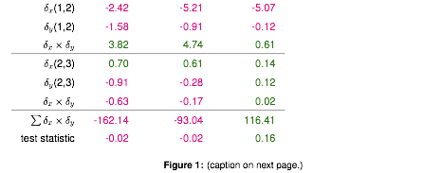

Slide 7
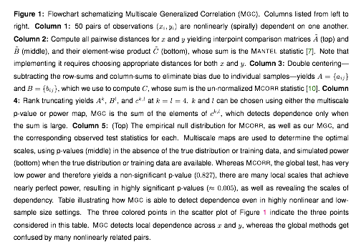

Slide 8
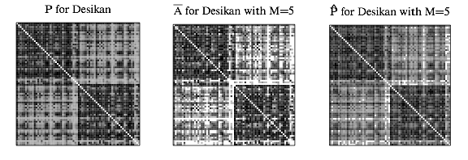
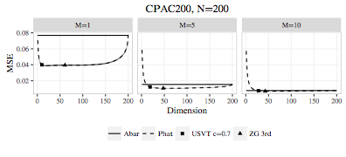
Law of Large Graphs
Average connectome is a key result of the $40M Human Connectome Project
For nearly all studies, sample size is small, and for all clinical studies, cohort size is even smaller (~5)
Proved our low-rank estimator is asymptotically more efficient (smaller errorbars) than the naive estimator
In practice, our low-rank estimator for connectomes yields better estimates whenever sample size is < 10 (which is typical)

Slide 9
MRI Batch effect
Batch effects are sources of variance due to experimental conditions
For clinical utility, batch effects must be mitigated
Removing batch effects is the key statistical step to move from research to clinic
We demonstrate using 15 different datasets processed the exact same way that batch effects completely eliminate signal
Standard methods for batch removal failed

Slide 10
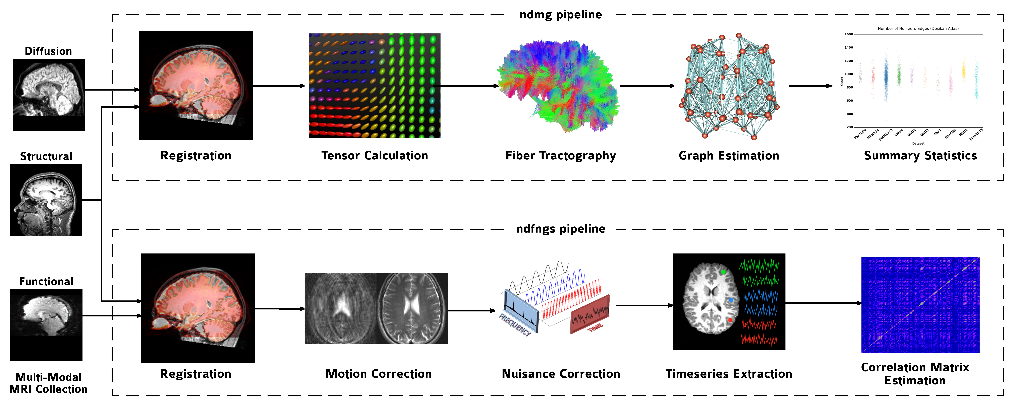
Multimodal MRI Pipeline
Pipeline is open source, fully reproducible and distributed: https://github.com/neurodata/ndmg
Can be 1-click launched via Docker or Singularity: https://github.com/neurodata/ndmg/blob/master/Dockerfiles/README.md
Optimized to maximize subject discriminability & all subsequent inferences
Requires about 1 hr per subject per core to run.

Slide 11
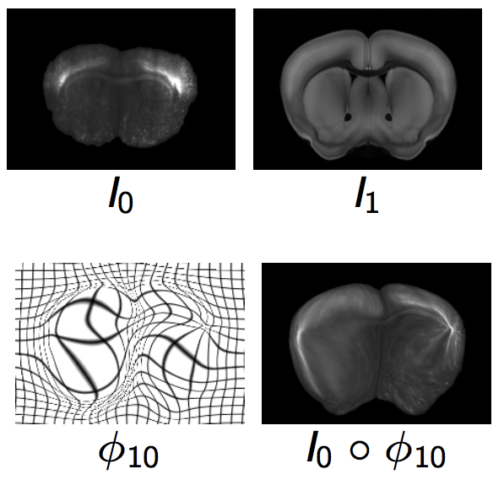
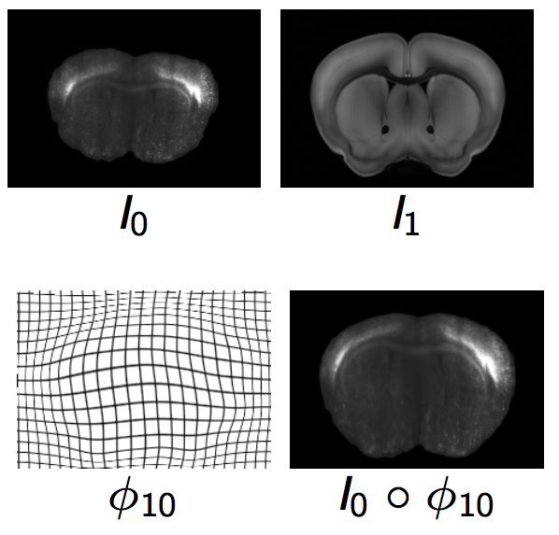
Multimodal Nonlinear Registration
CLARITY brains are increasingly important
Registering to one another and histology atlases is key to understanding
Multimodal data are bright in different places
Squared Error Nonlinear registration (LDDMM) maps bright spots to bright spots, which fails (top figure)
Mutual information LDDMM solves this problem (bottom figure)

Slide 12
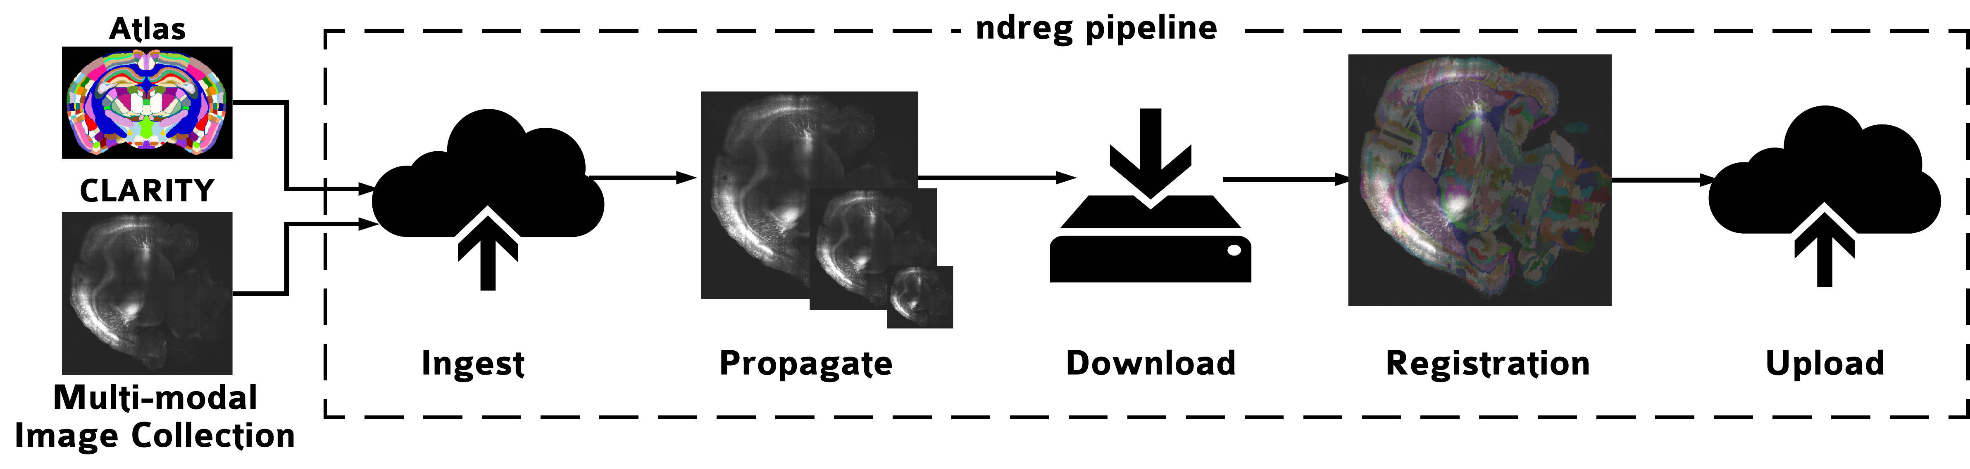
Multimodal Image Pipeline
CLARITY datasets are 1-10 terabytes (TB), so we store data in spatial database in cloud
Atlases are much smaller, and different modalities, so registration require multimodal techniques and resampling
Requires about 3 hr per per brain per core to run.

